Slide 1
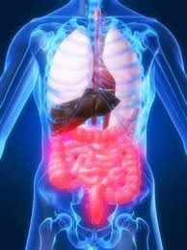
TREATING FUNCTIONAL GASTROINTESTINAL DISORDERS WITH HRV BIOFEEDBACK
Richard Gevirtz, PhD, BCB
Notes:
DrG
I want to thank you for inviting me to speak on Integrating Psychology in the Tx of Functional GI Disorders.

Slide 2
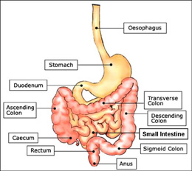
Intestinal surface area 100 times greater than skin surface area

Slide 3
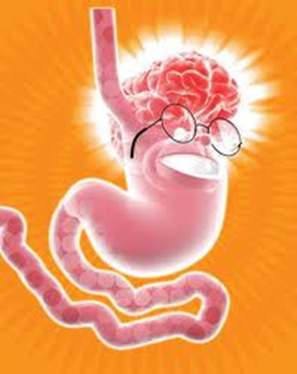
The Enteric Nervous System:
The Second Brain
Notes:
MJ
It is important to understand the Brain-Gut axis. Keep in mind that each one of the functions that we will be discussing could be a short course in its own right. For the sake of time, we want to provide you with a brief understanding of the pathophysiology, but more particularly the relevant physiological connections for forming a model relevant to biofeedback practitioners.
The Enteric Nervous System contains 10^8 neurons. Approximately the same amount as the spinal cord.
Since there are relatively few ANS postganglionic receptors, the ENS is largely an independently functioning nervous system. Though most consider the ENS to be a subdivision of the ANS, there are some who consider the ENS to be its own autonomous nervous system.

Slide 4
Enteric Nervous System(ENS)
“The Second Brain”(Gershon)
10⁹ nerve cells= number in spinal cord
Needed considering the challenge posed by the size and complexity of the luminal environment
(100 trillion micro-organisms from 40,000 species with 1oo times the number of genes in the human genome)
Located between circular and longitudinal muscle layers
  myenteric plexus and sub-mucosal plexus
Sympathetic fibers innervate the circular muscle layer
“Based on its close bidirectional connections with limbic and autonomic regions of the brain, the ENS can be viewed as a peripheral extension of the limbic system into the gut, where it is exposed closely tour complex internal environment, including powerful mechanical, chemical, and microbial influences. Alternatively, parts of the CNS(in particular the pontine, autonomic and limbic circuits) can be viewed as an encephalized portion of the ENS (Mayer,2011, p.454)

Slide 5
serotonin and the Gut
(5-hydroxytryptaine, 5-HT)
95% of bodies serotonin in found in the gut
Highly concentrated in myenteric plexus
Plays significant role in sending afferent signals into the vagus nerve
Activates (indirectly) peristalsis
(Older drugs)
5-HT-3 = antagonist (alosetron) (diarrhea predominant), 5-HT-4 = agonist (teserod)(constipation predominant)

Slide 6
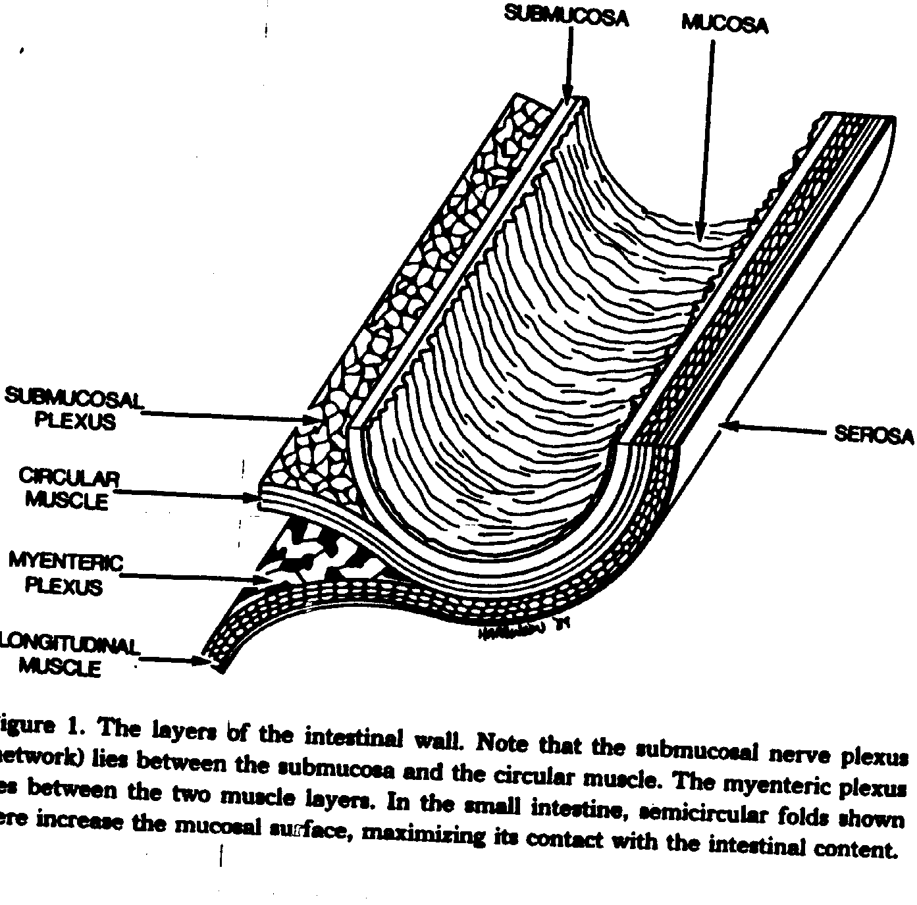

Slide 7
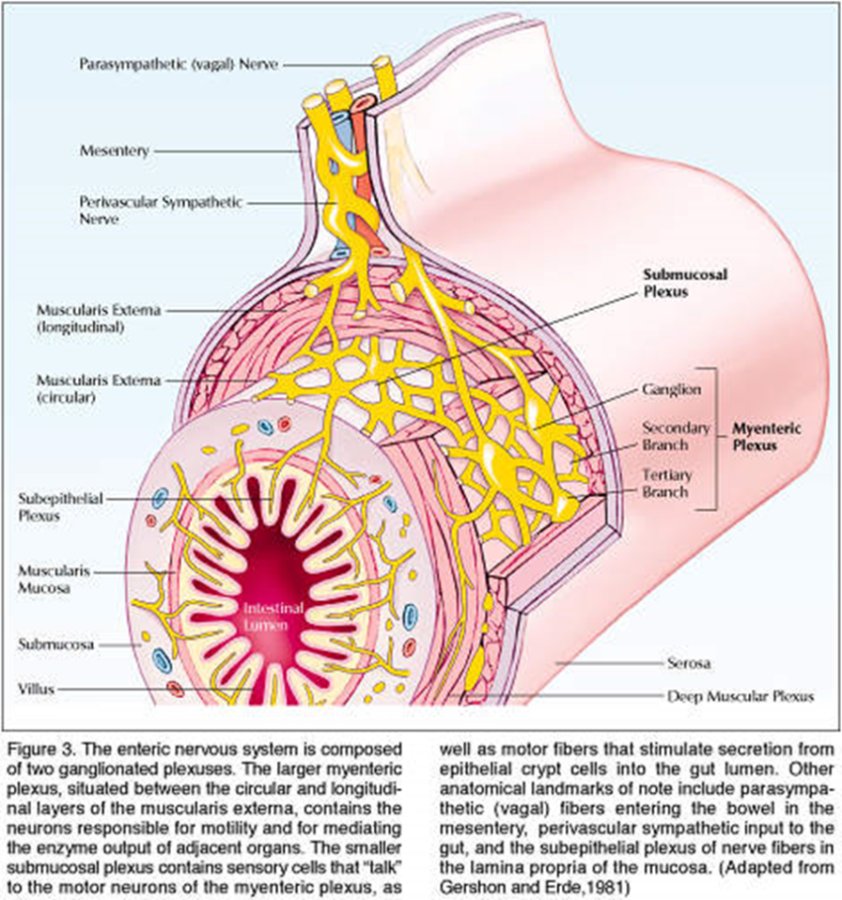
Enteric Nervous System
Myenteric Plexus
  Motility
  Primarily PNS input
Submucosal plexus
  Regulation of water and electrolytes.
  Motor and pain sensation
  Primarily SNS input
(Goyal & Hirano, 1996; Janig, 2006)
Notes:
DrG
The brain-gut axis is predominantly controlled by afferent and efferent ANS signaling to the enteric nervous system (ENS).
There are two plexuses of interconnected neurons found in layers of the entire GIT lining that communicate with extrinsic sympathetic and parasympathic fibers.

Slide 8
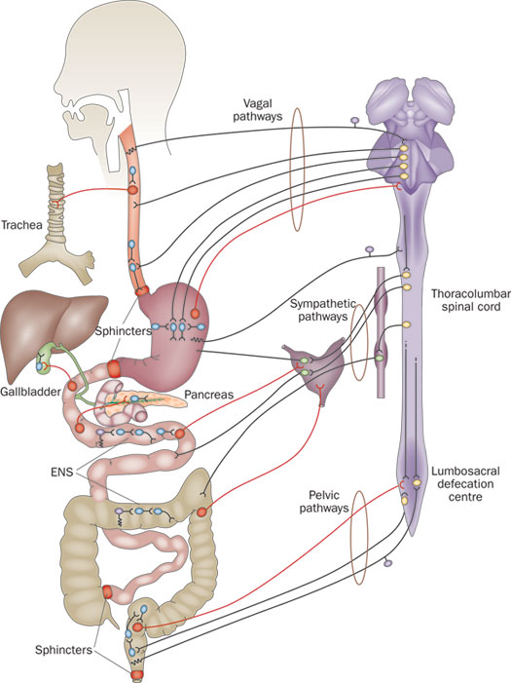
Notes:
DrG

Slide 9
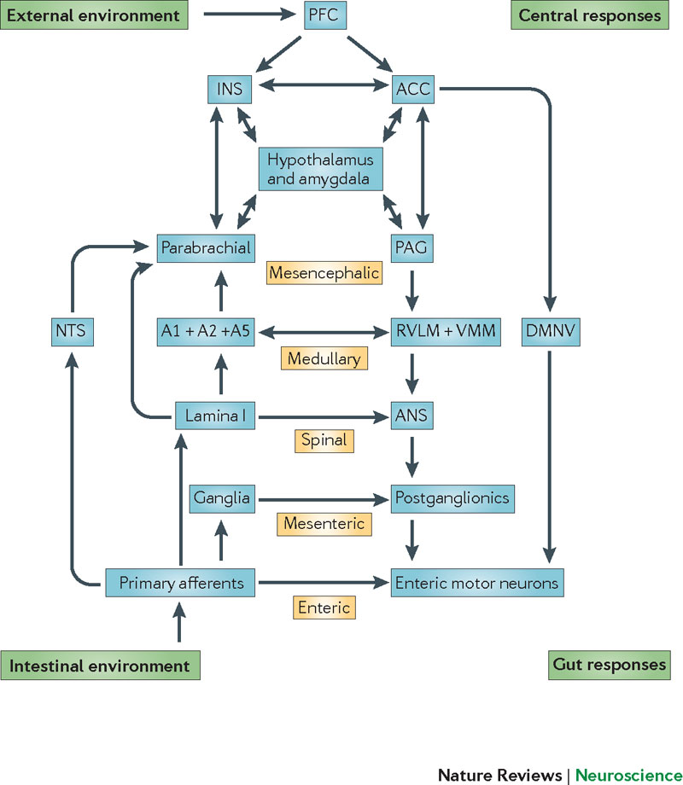
system.
The brain–gut axis can be conceptualized as a hierarchy of reflexes, from the reflex circuits contained within the enteric nervous system to the highest reflex loop involving the insular cortex and anterior cingulate cortex (ACC)
Mayer,2011

Slide 10
Brain-Gut Interaction
Parasympathetic Nervous System
      Dominant excitatory control of ENS
      Regulation of motility (excitatory and inhibitory)
      Regulation of exocrine secretion
      Regulation of hormone release
Sympathetic Nervous System
      Sensorimotor and visceral blood vessels throughout GIT.
      Inhibits motility by reducing excitatory transmitters.
      Responsible for afferent pain signals
(Goyal & Hirano, 1996; Janig, 2006).
Notes:
RG
The Parasympathetic Nervous System is the dominant excitatory control of the ENS and responsible for…..
Preganglionic neurons in the DMNX may influence the motility of the GIT by excitation and inhibition of smooth muscle directly or via ICC, and by activation of endocrine and hormone release. Other PNS neurons innervate secretomotor neurons in the submucosal plexus.
SNS inhibition of enteric neurons occur by either direct innervation of the mucosa or by innervation of the non-sphincteric smooth muscles.

Slide 11
Gut to Brain Communication
Endocrine, immune and neuronal afferent signaling from the gut to the CNS through vagal and spinal afferents to brain stem and spinal cord respectively.

Slide 12
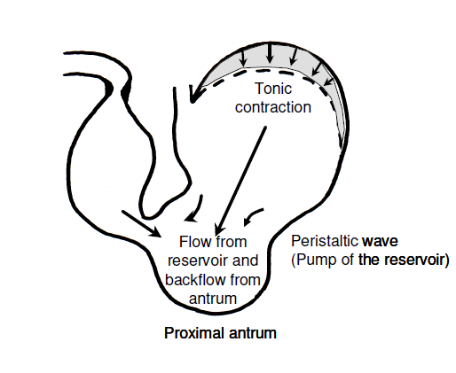
Motor control of the Gut - extrinsic (ANS) and intrinsic (internal reflexes and interdigestive neurotransmission) – Peristalsis
Vagus Relay Station
  Gastric emptying
  ACH – excitatory (contraction)
  NO, VIP, ATP – inhibitory (relaxation)
Colonic Motility (emptying) is largely under control of the ANS
  PNS – excites motility
  SNS – inhibits motility
(Ehrlein & Schemann, n.d.)
Notes:
Each area and structure has distinct normal electro-physiological function, which when disrupted can cause functional pathology. Were gonna start at the bottom and work our way up.
Gastric emptying starts in the stomach. The motor control of the gut (or motility) is controlled by both extrinsic (PNS) and internal reflexes. Peristalisic waves move contents from the gastric reservoir through the antrum by a jet-like propulsion.
Throughout the GIT, the ENS acts as a vagus relay station sending excitatory/inhibitory signals back to vagal afferents which then relay back into the tract.
Colonic motility is largely extrinsic. PNS excites motility, SNS inhibits motility.
Rob

Slide 13
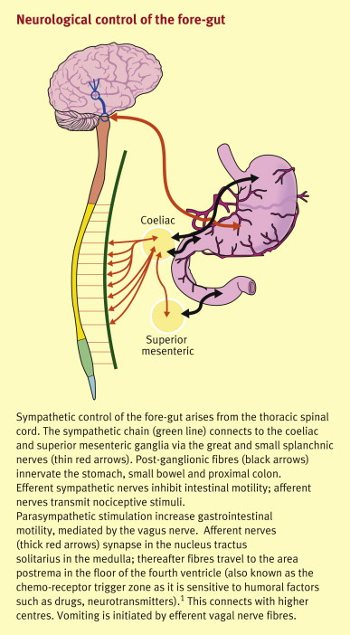

Slide 14
Vagal Withdrawal: An alternative to Sympathetic Activation
.: Neurosci Biobehav Rev. 1995 Summer;19(2):225-33.
  Cardiac vagal tone: a physiological index of stress.
  Porges SW.
  Institute for Child Study, University of Maryland, College Park 20742, USA.
  Cardiac vagal tone is proposed as a novel index of stress and stress vulnerability in mammals. A model is described that emphasizes the role of the parasympathetic nervous system and particularly the vagus nerve in defining stress. The model details the importance of a branch of the vagus originating in the nucleus ambiguus. In mammals the nucleus ambiguus not only coordinates sucking, swallowing, and breathing, but it also regulates heart rate and vocalizations in response to stressors. In mammals it is possible, by quantifying the amplitude of respiratory sinus arrhythmia, to assess the tonic and phasic regulation of the vagal pathways originating in the nucleus ambiguus. Measurement of this component of vagal tone is proposed as a method to assess, on an individual basis, both stress and the vulnerability to stress.
Notes:
DrG

Slide 15
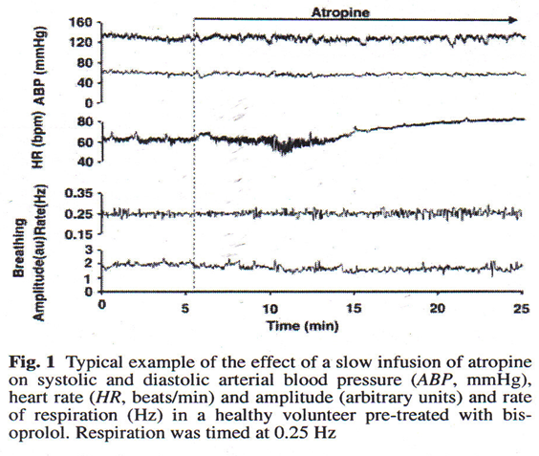

Slide 16
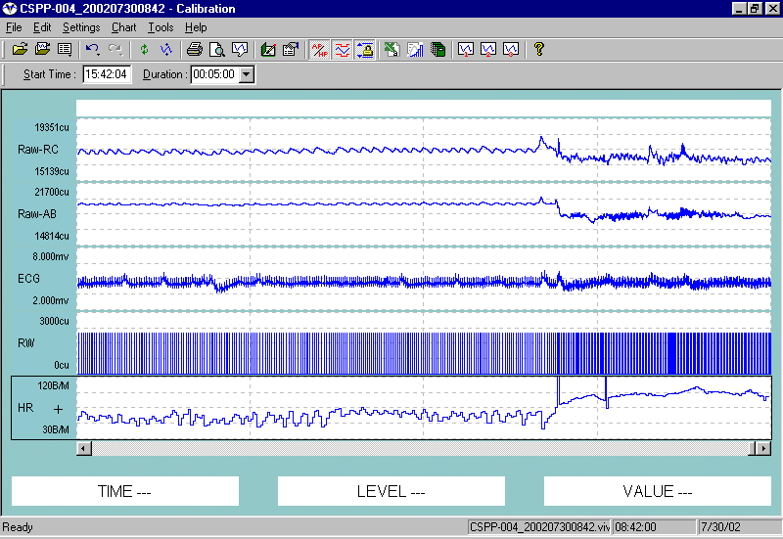
Worrying about being late for an appointment. See FFT B
33 Br/min
13 Br/Min
Driving. See FFT A

Slide 17
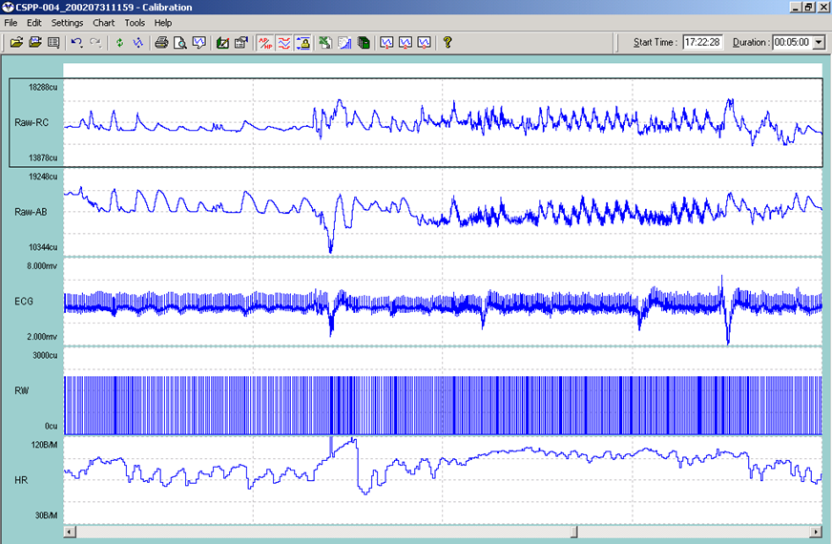
Anxiety attack while driving home

Slide 18
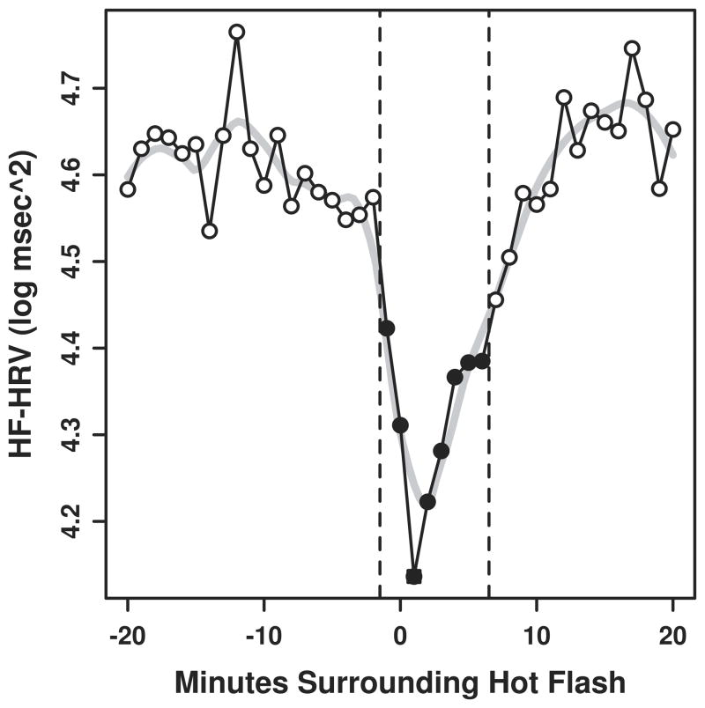
Figure 1
Minute by minute changes in HF-HRV during hot flash
Note: Closed circles represent minutes significantly different from open circles at p<0.05, N=21
Hot flashes and cardiac vagal control during women's daily lives
Menopause. ;19(4):406-412.

Slide 19
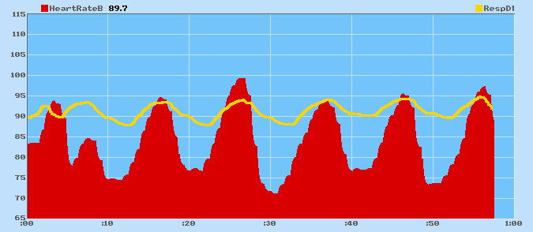
Example of RSA
Peak/valley differences
= vagal tone when resp is
in normal range
Notice how heart rate increases with inhale. Heart rate decreases with exhale. This pattern shows high vagal tone (high PSNS activity) and a high amount of heart rate variability.
Respiration Heart Rate

Slide 20
Respiratory Influences
HR changes related to respiration are called respiratory sinus arrhythmia (RSA).
HR increases with inhalation. HR decreases with exhalation.
Amount of HR change with breathing is used as an index of vagal “tone”.

Slide 21
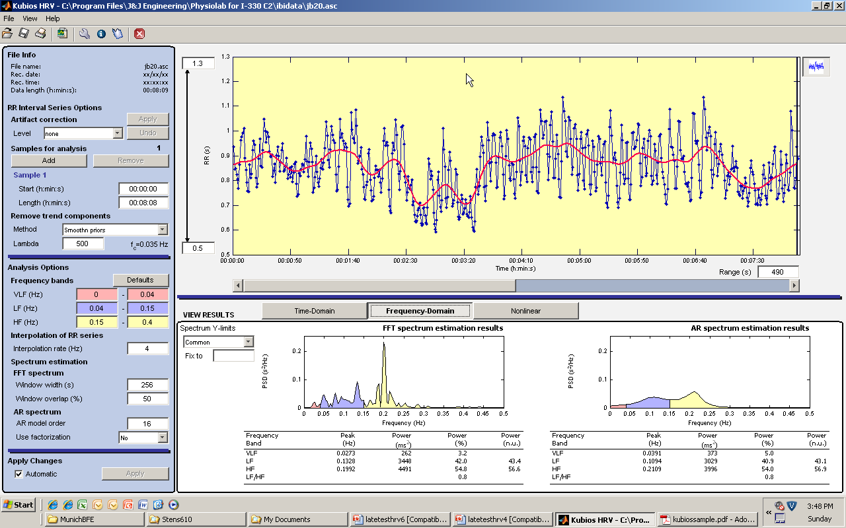
Natural log of HF power ms² is our measure of vagal tone. Ln 4491=8.41

Slide 22
Defining FGIDs
Chronic or recurrent GI symptoms that do not have an underlying medical pathophysiology.
FGIDs are typically marked by the absence of any objective markers of disease, such as inflammation, infection, or structural abnormality.
FGIDs were largely rule-out Diagnoses, until Rome Diagnostic criteria came out to positively identify these diagnoses based on symptoms
3747 of 5430 (69%) reported experiencing criteria for at least 1 of 20 functional GI syndromes (Drossman et al., 1993)
FGIDs make up 41% of GI disorders seen by doctors and therapists. (IFFGID.org)
(Corazziari, 2004; Drossman, 2006; McOmber & Shulman, 2008; Palsson & Whitehead, 2013)
Notes:
RG
Traditionally, FGIDs are viewed as….
Moving away from Sx based rule out disorders, the majority research utilizes Rome III diagnostic criteria to identify positive symptomology.
What I want to emphasize today is that there are clear physiological mechanisms mediating these disorders and moderated by factors that are relevant for treatment planning.

Slide 23
Rome-III Criteria - IBS
Recurrent abdominal pain or discomfort** at least 3 days/month in the last 3 months associated with two or more of the following:
a. Improvement with defecation
b. Onset associated with a change in frequency of stool
c. Onset associated with a change in form (appearance) of stool
No evidence of an inﬂammatory, anatomic, metabolic, or neoplastic process that explains the subject’s symptoms
* Criterion fulfilled for the last 3 months with symptom onset at least 6 months prior to diagnosis
** “Discomfort” means an uncomfortable sensation not described as pain.
Notes:
MJ
Many distinguish between Diarrhea predominant (IBS-D), Constipation predominant (IBS-C) and Mixed symptoms (IBS-M).

Slide 24
Psychosocial Factors
Personality
    Neuroticism
    Perfectionistic
    MMPI-2 – Conversion V - somatization
    Increased sensitivity to anxiety
    High Achieving
    Moralistic
    Interpersonal sensitivity and possibly lower higher introversion
GI Specific Anxiety significant predictor
Coping Behaviors
    Avoidant patterns (situations, specific foods, etc.)
    Control (lack of acceptance) – Excessive consultations and tests
    Anger suppression – internalizers
    Catastrophizers
    Goal oriented problem solvers
Psychological Comorbidity
    Anxiety – predictor, not outcome
    Depression
Developmental
    Anxious mother’s (RAP)
    Hx of Trauma/Abuse
(Farnam, Somi, Sarami, & Farhang, 2008; ; Ferreira, 2011 ; Hobbis, Turpin, & Read, 2003; Koloski et al., 2012; Jansdottir, 1997; Surdea-Blaga, Baban, & Dumitrascu, 2012; Straub, 2012; Sulkowska et al. 2008; Rey et al., 2009)
Notes:
MJ
There appears to be overlapping personality profiles among FGID patients.
FGID patients also share similar maladaptive coping mechanisms.
Anxiety was found to precede and predict the onset of IBS.

Slide 25
Biopsychosocial Model of FGID
(Drossman, 2006)
Notes:
MJ
Data clearly shows that biological vulnerability is mediated and moderated by feedback loops between psychophysiological and enteric activity leading FGID symptoms.
This year, Jones and colleagues investigated 34 biomarkers and 4 psychological markers as possible diagnostic tools for IBS. Supporting the biopsychosocial model for IBS, they found that the discriminating IBS from healthy controls was stronger with psychological markers alone (area under curve = .86) than the full assay of biomarkers (area under curve = .81). Combined, the full assessment accounted for an area under the curve of .93.
The AGA urges utilization of the biopsychosocial model for treatment planning IBS care.

Slide 26
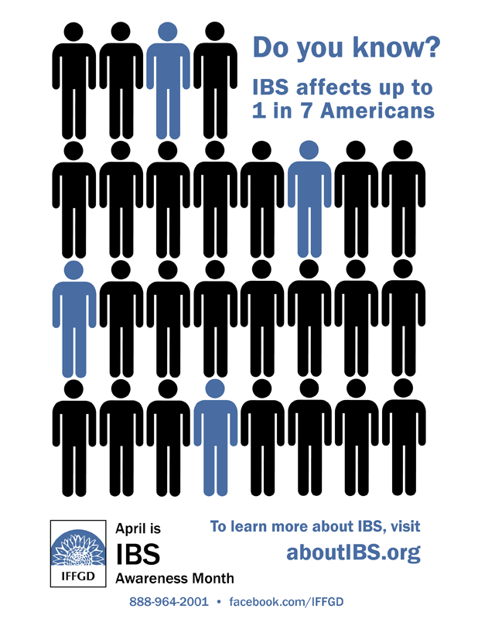
Epidemiology - IBS
IBS is the most commonly reported FGID at 41%.
IBS alone accounts for 25% of all GI disorders seen by GI specialists and 12% of primary care.
Health Care
    $20 billion dollars annually
    Increased health care utilization by over 50%
      GP visits - 3.88 annual compared to 1.77
      1.64 visits to GI compared to .009.
(American Gastroenterological Association, 2002; Schuster, 2001; Thompson et al., 2002)
Notes:
MJ
Combined direct and indirect costs of IBS were estimated at

Slide 27
IBS - Pathophysiology
Heightened Visceral Sensitivity
  Distention sensitivity
  Post-infection IBS vs IBS without infection (Tougas, 2000)
  Presence of Corticotropin Releasing Factor (CRF) appears to moderate distension pain perception in IBS
Heart Rate Variability
Subtypes
  Low HRV
  Sympathetic dominance
  Poor vagal tone
  IBS-Constipation:
  PNS dysfunction
  IBS-Diarrhea:
    SNS dysfunction
(Aggarwal, 1994; Mazur et al., 2007; Orr, Elsenbruch, & Harnish, 2000; Pellissier, Dantzer, Canini, Mathieu, & Bonaz, 2010; Task Force of the European Society of Cardiology , 1996)
Notes:
MJ
In IBS patients, it has been suggested that pain is perceived at much lower levels of distension (the stretching of the tract). This is known as the 'hypersensitive gut' or in scientific terms visceral hyperalgesia. However, evidence appears to that the hypersensitive gut is primarily occurs in IBS with a history of GI infection.
There is some evidence indicating subtypes are differentiated by autonomic dysfunction.

Slide 28
Pathophysiology II
A meta-analysis of studies relating gut (rectal) distention in IBS patients found “…greater activation of brain regions that are involved in the processing of visceral afferent information, in emotional arousal and in cortical modulation(Mayer,2011, p.462)
Paulus and Stein’s Interoceptive mismatch theory
  “The mismatch of actual interoceptive input reaching the anterior insula (aINS) through body to brain signaling, with falsely predicted interoceptive state (from …memory of limbic influences) result in the engagement of the anterior cingulate cortex (ACC)”(Mayer, 2011,p. 464).

Slide 29
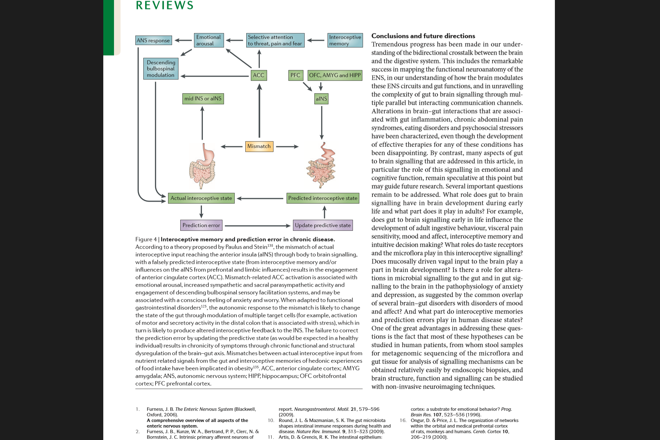
Paulus and Jones Mismatch Theory
The beneficial influence of probiotics was abolished by vagotomy.

Slide 30
Rome-III Criteria – FAP (S)
Functional Abdominal Pain
Childhood Functional Abdominal Pain Syndrome
Diagnostic criteria* Must satisfy criteria for childhood functional abdominal pain and
have at least 25% of the time one or more of the following:
Some loss of daily functioning
Additional somatic symptoms such as headache, limb pain, or diﬃculty
Sleeping
* Criteria fulﬁlled at least once per week for at least 2 months prior to diagnosis
Must include all of the following:
Episodic or continuous abdominal pain
Insuﬃcient criteria for other FGIDs
No evidence of an inﬂammatory, anatomic, metabolic, or neoplastic process
that explains the subject’s symptoms
* Criteria fulﬁlled at least once per week for at least 2 months prior to diagnosis
Notes:
RG

Slide 31

Epidemiology – FAP(S)
FAP affects approximately 10-15% of the population
      10-25% of children are affected (UNC Center for Functional GI & Motility Disorders)
      FAP can occur later in adulthood
Health Care
      Estimated $9,000 per individual Not accounting for out of pocket expenses
Cause for disruption of daily activities
      Missed school days
      Over-utilization of healthcare
      Unnecessary surgeries
      Learning difficulties
      Anxiety
(Apley & Nash, 1958; DiPalma & DiPalma, 1997; Hyams et al., 1996; Kristjansdottir, 1996; Nyrop et al., 2007; Oster 1972; Parcel et al., 1997)
Notes:
RG
FAP affects approximately 10-15% of the population.
10-25% of children are affected (UNC Center for Functional GI & Motility Disorders)
FAP can occur later in adulthood (UNC Center for Functional GI & Motility Disorders)
Health Care
Estimated $9,000 per individual.
Not accounting for out of pocket expenses.
Cause for disruption of daily activities
Missed school days.
Over-utilization of healthcare.
Unnecessary surgeries.
Learning difficulties.

Slide 32
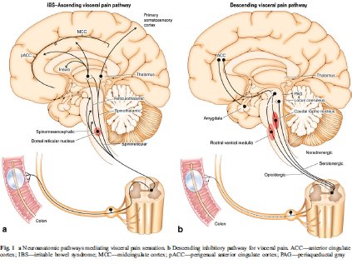
FAP/RAP - Pathophysiology
No gut pathology
Parasympathetic associated with sensations of hunger and satiety
Sympathetic associated with visceral pain
Associated with low baseline vagal tone and high LF/HF ratio compared to healthy controls
Self-reported decreases in pain directly correlated with decreases in LF suggesting sympathetic component to pain
(Holzl & Whitehead, 1983; Sperber & Drossman, 2010; Grover & Drossman, 2010; Nozu & Okumura, 2011)
Notes:
RG
Very unique from other FGIDs b/c….
Abnormal perception of normal gut function
There is little or no gastrointestinal disturbance found in these patients, unlike IBS which is a motility disorder.
PNS bullet
SNS bullet
Unlike pain associated w/ IBS, there appears to be no difference in pain sensitivity with distention compared to controls
However, these patients seem to have Hypoactive recognition of non-noxious physiological distention
Inconsistent visceral sensitivity in lower and higher pressures
Considered largely CNS disorder of the Gate control for pain
Failure to inhibit and possible amplification of the visceral pain afferent signals
Rob
In normal people, distension of the gut will trigger nerve fibers lining the gut to transmit signals to higher centers in the brain that register pain.

Slide 33
Vulnerabilities: Genetics/familial,
Infections, Trauma, etc.
Internalizing emotional style:
Worryer, Sensitive to criticism,
Anxious, People pleaser, etc
Vagal Withdrawal
Disruption of Myenteric-Serotonergic System and CNS Sensitization of Afferent Pathways
GI symptoms: Pain, Constipation, Diarrhea, Bloating
Psychophysiological Model

Slide 34
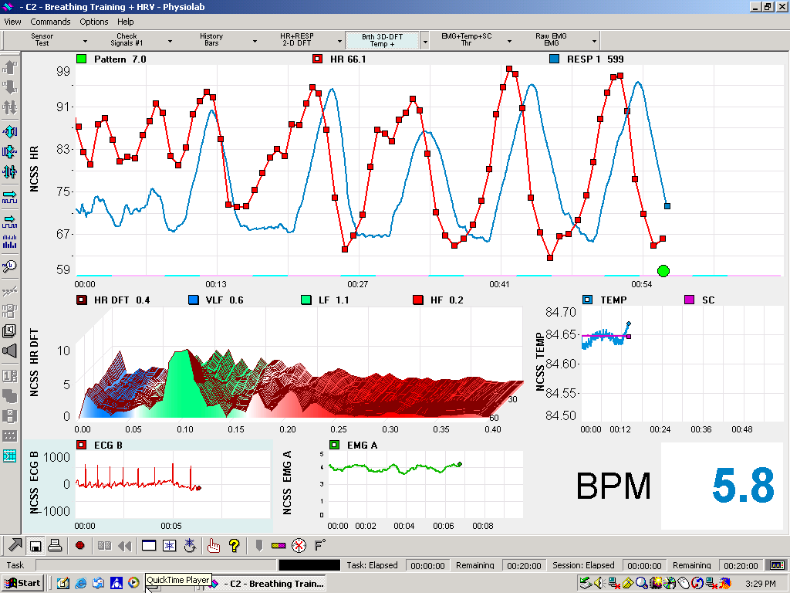
Vulnerabilities: Genetics/familial,
Infections, Trauma, etc.
Internalizing emotional style:
Worryer, Sensitive to criticism,
Anxious, People pleaser, etc
HRVB to strengthen autonomic homeostasis, accentuated antagonism and
Modify CNS processing?
Vagal Withdrawal
CBT, ACT, Family Interventions
Disruption of Myenteric-Serotonergic System and CNS Sensitization of Afferent Pathways
GI symptoms: Pain, Constipation, Diarrhea, Bloating
Intervention Points

Slide 35
FAP/RAP - Pathophysiology
Chronic vagal withdrawal associated with internalizing emotional states (i.e. worrying)
Sowder et al. (2010) found
  Children and adolescents with FAP showed less vagal tone at rest
Notes:
RG

Slide 36
Efficacy and Mechanism Data

Slide 37
Visual Analog scale from daily pain diary records, pre & post treatment, by group
Pre = Pre-treatment
Post = Post-treatment
4 component = fiber+biofeedback+cognitive restructuring+parental support
3 component = fiber+biofeedback+cognitive restructuring
2 component = fiber+biofeedback
Humphreys, P. & Gevirtz, R. (2000) Treatment of recurrent abdominal pain: components analysis of four treatment protocols. Journal of Pediatric Gastroenterology and Nuitrition, 31 (1), 47-51.

Slide 38
Figure 2. Parent observation rating of pain, pre & post treatment, by group
(Humphreys& Gevirtz, 2000)
Pre = Pre-treatment
Post = Post-treatment
4 component = fiber + biofeedback + cognitive restructuring + parental support
3 component = fiber + biofeedback + cognitive restructuring
2 component = fiber + biofeedback

Slide 39
Appl Psychophysiol Biofeedback. 2010 Sep;35(3):199-206. Restoration of vagal tone: a possible mechanism for functional abdominal pain.
Sowder E, Gevirtz R, Shapiro W, Ebert C.
Notes:
1 minute

Slide 40
RAP Patients and Healthy Control Participants
RAP
  Inclusion Criteria
    RAP diagnosis
    Ages 5-17
    Female and male
  Exclusion Criteria
    Lactose Intolerant
    Urinary tract infections
    Recent head trauma
    Medications that could interfere with treatment
    Current medical treatment for RAP
    Recent/ related surgical procedure before/ during biofeedback
    Remarkable mental status
Healthy Control
  Inclusion Criteria
    Healthy
    Ages 5-17
    Female and male
  Exclusion Criteria
    Medications
    Remarkable mental status

Slide 41
Procedures
RAP group (n=20)
  Reviewed patients’ medical records at Kaiser/Children’s Specialists
    Routine 6 HRV biofeedback sessions conducted on-site
    2 sessions ambulatory HRV monitoring
Healthy control group (n=10)
  Recruited participants (verbal / flyers) during well-checks at Kaiser / Children’s Specialists
    2 sessions ambulatory HRV monitoring

Slide 42


Pre/Post Assessment:
VivoMetrics, Inc. LifeShirt,tm
The first non-invasive, ambulatory monitoring system that continuously collects, records and analyzes a broad range of cardiopulmonary parameters.
Made it possible to monitor children in their natural environments over a full day.

Slide 43
Procedures
Healthy Control Group
Attend Kaiser or Children’s Specialists for 2 30-minute sessions (8 weeks apart) to connect LifeShirt
Non-invasively monitored during 4 to 8 hours of daily activities both occasions.
Total participating time, including explanation of the study and forms, ambulatory monitoring sessions, and answering any questions, was approximately 9-17 hours.

Slide 44
Procedures
HRV Biofeedback for RAP group
Patients diagnosed with RAP by a pediatric gastroenterologist and referred for Heart Rate Variability (HRV) Biofeedback.
Patients seen by 1 of 3 pre-doctoral interns at Kaiser Permanente Pediatric Gastroenterology Department or Children’s Specialists of San Diego for an average of 6 sessions.
All sessions were conducted in a treatment room or medical office at Kaiser Permanente or Children’s Specialists of San Diego.
Notes:
Ped GI = Dr. Shapiro, Psych, PHD = Dr. Gevirtz

Slide 45
Notes:
Graph supports hypothesis that RAP patients would have increase %LF after 6 weekly sessions of HRV biofeedback. The standard error bars represent 1 standard error.
Figure 1: Mean changes (with standard error bars) in low frequency activity percentage value during resonant frequency breathing in the RAP
Manipulation Check
Paired-samples t-tests were conducted to evaluate differences in LF% (after completion of HRV biofeedback treatment) in percentage value for low frequency (%LF) during resonant frequency breathing, Percent LF is a heart rate frequency domain measure used to assess autonomic control. The researcher found a statistically significant increase in %LF from time one (M= 57.85, SD= 15.53) to time two, (M= 73.30, SD= 9.85), t (19) = -4.33, p=.001 (see Figure 1). The eta squared statistic (.50) indicated a very large effect size.

Slide 46
0
Notes:
Figure 2: Mean changes (with standard error bars) in low to high frequency ratios in the recurrent abdominal pain group versus the control group from time one to time two across eight weeks. (Data has been corrected for the effects of respiration and accelerometer).
A mixed between-within ANOVA with one repeated measure investigated differences between the groups in LF:HF changes from time one to time two. The interaction was significant: F (1, 28) =6.83, p=.014 (see Figure 2). Independent-samples t-tests were conducted to compare whether children with RAP had higher LF:HF than did children without RAP. Within each group, time one and time two were examined. The simple effects analysis showed that the groups differed at time one [t (28) =2.95, p=.006] but not at time two [t (28) = -.21, p=.838]. The magnitude of the differences between the two groups at time one was large (eta squared=.24). Means and standard deviations for the dependent variable for both groups at time one and time two are shown in Table 2.
Paired-samples t-tests were conducted to evaluate the differences from time one to time two in LF:HF for both the RAP group and the control group. A statistically significant decrease occurred in the RAP group’s LF:HF from time one (M= 2.50, SD= .13) to time two (M=2.40, SD= .18), t (19) =2.57, p=.019. The eta squared statistic (.26) indicated a large effect size. There was no significant change in the control group’s LF:HF from time one (M= 2.34, SD= .17) to time two (M= 2.41, SD= .22), t (9) = -1.43, p=.187.

Slide 47
RAP
Notes:
Pain Outcome Measures for the RAP Group
For the RAP group, pain measures were compared at time one and at time two after completing HRV biofeedback using paired-samples t-tests to evaluate the impact of the treatment on the RAP groups’ pain frequency and pain intensity scores.
There was a statistically significant decrease in pain frequency from time one (M=4.65, SD=1.90) to time two (M=1.65, SD=1.27), t (19) = 6.16, p<.001 (see Figure 3). The eta squared statistic (.67) indicated a very large effect size.
Figure 3: Mean change (with standard error bars) in pain frequency in the recurrent abdominal pain group from time one to time two (eight weeks later), after completion of heart rate variability biofeedback treatment. Pain frequency was measured by number of reported pain episodes per week.

Slide 48
RAP
Notes:
There was also a statistically significant decrease in pain intensity from time one (M=6.60, SD=2.37) to time two (M=2.75, SD=2.22), t (19) = 7.07, p<.001 (see Figure 4). The eta squared statistic (.73) indicated a very large effect size. Clinically, these results reflect the fact that 75% of the treated RAP patients showed clinically significant reductions in self-reported pain. 20% were actually pain-free by post test.
Figure 4: Mean change (with standard error bars) in pain intensity in the recurrent abdominal pain group from time one to time two (eight weeks later), after completion of heart rate variability biofeedback treatment. Pain intensity was measured using a visual analogue scale with a rating scale from one to ten, with one equaling least severe pain and ten equaling most severe pain.

Slide 49
Notes:
Pearson Correlations were used to investigate whether changes in the RAP group’s pain frequency and pain intensity were related to the change in LF:HF from time one to time two. There was a strong, positive correlation between a decrease in LF:HF and a decrease in pain frequency, r=.54, p=.018, from time one to time two (see Figure 5). There was also a strong, positive correlation between a decrease in LF:HF and a decrease in pain intensity, r=.62, p=.004, from time one to time two (see Figure 6).
Figure 5: The scatterplot shows the relationship between the RAP group’s changes (delta) in their low frequency to high frequency ratio, a measure of sympathovagal tone, compared to their changes (delta) in pain frequency over eight weeks at time one and time two. The term delta is defined here as changes in a variable over time.

Slide 50
Notes:
Figure 6: The scatterplot shows the relationship between the RAP group’s changes(delta) in their low frequency to high frequency ratio, a measure of sympathovagal tone, compared to their changes (delta) in pain frequency over eight weeks at time one and time two. The term delta is defined here as changes in a variable over time.

Slide 51
Rome-III Criteria – GERD
Must include all of the following:
Burning retrosternal discomfort or pain
Absence of evidence that gastroesophageal acid reﬂux is the cause of the symptom
Absence of histopathology-based esophageal motility disorders
* Criteria fulﬁlled for the last 3 months with symptom onset at least 6 months prior to diagnosis
Other symptoms that may be caused by GERD are
  atypical chest pain
  hoarseness
  nausea
  cough
  Odynophagia
Notes:
DrG

Slide 52
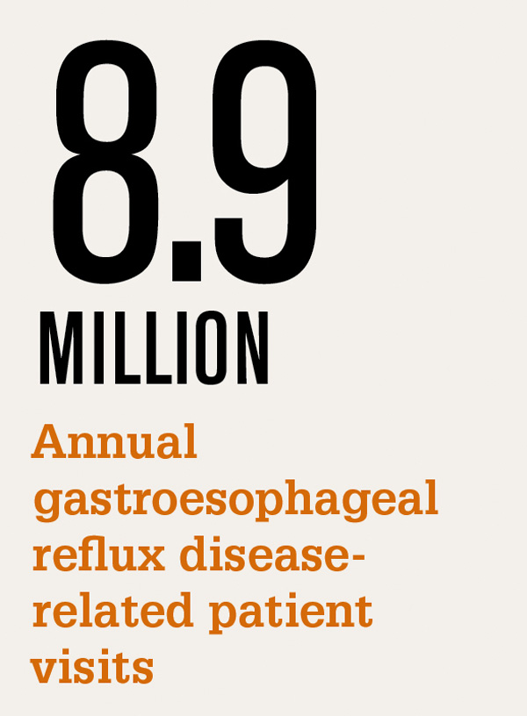
Epidemiology - GERD
Prevalence of this disease in Western communities has increased in recent decades
      Ranging from 26% to 60% prevalence in general population
Symptoms affects:
    Health-related QOL
    Reduce work productivity
    Lead to increase health-care utilization.
Health Care
    Eight billion dollars in the United States
    461 million pounds in the United Kingdom
(Axon, 2004; Delaney, 2004; Diaz-Rubio et al., 2004; Eisen, 2001; Haque et al., 2000; Hansen et al., 2009; Louis et al., 2002; Wahlquist et al., 2009; Wiklund, Carlsson, & Vakil, 2006)
Notes:
DrG
It seems that the prevalence of this disease in Western communities has increased in recent decades. (Personal view: to treat or not to treat? Helicobacter pylori and gastro-oesophageal reflux disease - an alternative hypothesis. Axon
Symptoms of gastro-esophageal reflux disease have prevalence in the general population ranging from 26% to 60% (Diaz-Rubio M; Haque; Louis)
GER symptoms affects many aspects of health-related quality of life, reduce work productivity, and lead to increased health-care resource utilization (Hansen; Wahlquist; Wiklund).
For example in the year 2000 approximately eight billion dollars in the United States and 461 million pounds in the United Kingdom were spent to treat GERD (Eisen, 2001; Delaney, 2004).

Slide 53
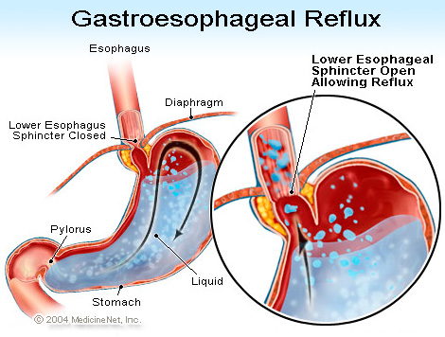
Gasroesophageal Reflux Disease(GERD) &NERD (Non-Erosive Reflux Disease)
Esophagus - muscular tube through which food passes from the pharynx to the stomach
Swallowing = Peristalsis
LES = barrier to stomach
LES is normally closed and contracted
LES relaxation occurs with swallowing - esophageal distension
LES (smooth muscle) is predominately controlled by vagal innervation with some sympathetic inputs
(Mitre & Katzka, 2004)
Notes:
DrG
Swallowing - food passes by process of peristalsis to the stomach.
LES = barrier to stomach
Stomach serves as a barrier to protect the esophageal mucosa and more proximal structure from potentially damaging substances in the stomach including gastric acid, pepsin and bile salts.
LES is normally closed and contracted
maintaining a minimum pressure level to ensure feed forward, but not retrograde propulsion.

Slide 54
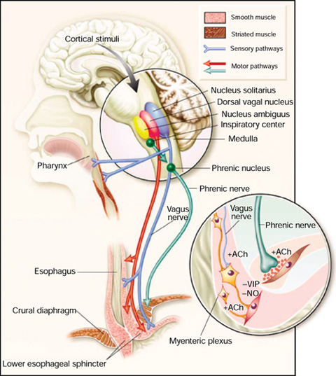
GERD cont’d
Lower Esophogeal Sphincter (LES) Incompetence
Tonic contraction of LES is primarily responsible for preventing reflux
Centrally mediated vagal dysfunction
HRV, HF, LF & VLF Dysfunction
(Pfeiffer, 2001; Dobrek, Nowakowski, Mazur, Herman & Thor, 2004)
Notes:
DrG
Note: Vagus nerve has both excitatory and inhibitory effects on the LES. Direct vagal innervation invariably leads to relaxation. More research is needed to understand how vagal tone influences either LES relaxation or contraction.
LES Incompetence
in some form of the LES is the predominant determinant of GERD.
Reflux is different in GERD vs. non-GERD patients
In non-GERD, the gastric distension mechanism is exclusively responsible for reflux - Transient Lower Esophageal Sphincter Relaxation (TSLER) are caused by reflexes associated with low cardiac vagal tone following a meal.
Centrally mediated vagal dysfunction
has been indicated as the primary cause of GERD causing not only low HRV, but
Mark

Slide 55
The effect of
psychophysiological autonomic modulation on
human oesophageal pain hypersensitivity
In a model of human oesophageal pain hypersensitivity in healthy subjects:
Does physiological modulation of the Autonomic Nervous System (ANS) influence the degree of oesophageal pain hypersensitivity (OPH)?
CA Botha, CH Knowles, Q Aziz
Neurogastroenterology Group,
Bart’s & The London School of Medicine & Dentistry,
Queen Mary University London, UK
Notes:
DrG

Slide 56
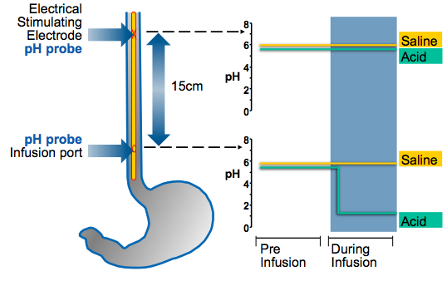
Methods 1: A reliable model of OPH
Notes:
DrG
Reliably and validated model of VPH
IN THIS MODEL WE USE A CATHETHER ASSEMBLEY WHICH HAS AN INFUSION PORT POSITION IN THE LOWER --
demonstrated…
… then we can measure the changes in PT in the Un exposed proximal oes
…demonstrably not injured

Slide 57
Methods 1: A reliable model of OPH
20
30 min
10
Saline
Change
in PT (%)
PT =
Pain Threshold
0
Pain Tolerance
Reduces
-10
Acid
-20
0
1
2
3
4
5
6
Time (hours)
Sarkar et al Lancet 2000
Notes:
DrG
Acid=sensitisation
Saline=habituation

Slide 58
Withdrawal of Cardiac Vagal Tone is associated with increased oesophageal pain hypersensitivity to acid
-5
-10
Change
In PT
(mA)
-15
What effect will an intentional INCREASE in Vagal Tone have on OPH?
-20
r = 0.54,
p = 0.031
-25
-3
-2
-1
0
1
Change in CVT (n=16)
Sharma et al, NGM 2012
Withdrawal of vagal tone,
increased OPH!
Notes:
DrG
USING A COMBINATION OF OUR ACID INDUCED ES HS model and cvt measurement we have made an interesting observation.
Individuals that withdrew vagal (parasympathetic) tone the most also developed the greatest oesophageal sensitisation and resultant pain hypersensitivity

Slide 59
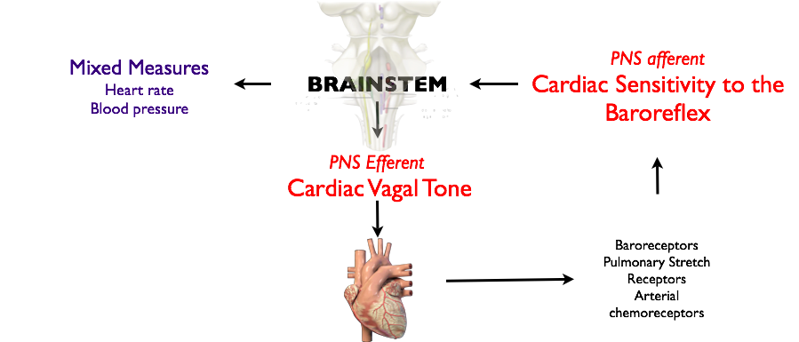
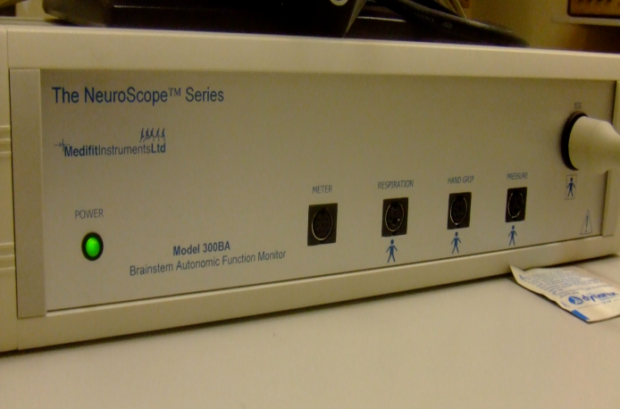
Methods 3: ‘Physiological increase in CVT’
Nucleus Ambiguus
at full inspiratory capacity in 4sec followed by
forced expiratory vital capacity in 6 sec
at a
frequency of 0.1Hz
(6 breaths / minute
over 5 min)
Deep Breathing
Protocol:
Thijs , Neurology 2007
Notes:
DrG
Controlled way in the lab using a deep breathing protocol
59

Slide 60
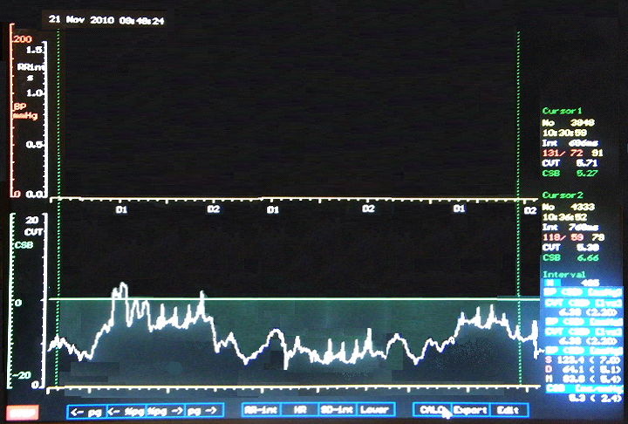
Method 4: ‘NeuroScope® Image’
Deep Breathing
Sham Breathing
Notes:
DrG

Slide 61
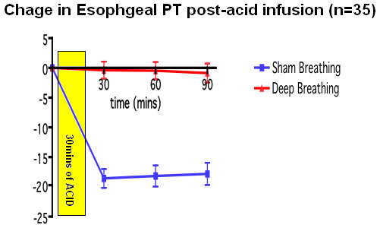


Results 4: Pain Threshold Data
Change in Oesophageal PT post-acid infusion (n=35)
*
*
*
Pain Tolerance
Increased
* Mean Δ: +17.61 mA (SE ±2.384) p=0.0002
Notes:
DrG
Response significantly attenuated

Slide 62
Parasympathetic “Accentuated Antagonism”
“Vagal ‘tone’ predominates over sympathetic tone at rest. Under normal physiological conditions, abrupt parasympathetic stimulation will inhibit tonic sympathetic activation and its effects at rest and during exercise. This response is known as ‘accentuated antagonism’ “(Olshansky et al., 2011, p.863; Yang and Levy, 1984; Schwegler and Jacob, 1975; Levy, and Zieske, 1969)
Notes:
DrG

Slide 63
State of Treatments
Dietary changes
Fiber, bulking agents and laxatives
Antispasmodics
Antidiarrheals
Surgery
5HT and 5HT receptor agonists
Anti-Depressants
Psychotherapy
(Brandt et al., 2009; Longstreth, G. 2007; Saito, Locke, Weaver, Zinsmeister, & Talley, 2005; Whitehead, Palsson, Levy, Von Korff, Feld & Turner, 2003)
Notes:
RG
We can make a difference to patient outcomes.
Patients believe that certain foods may exacerbate their symptoms. In the absence of specific food allergies or intolerance, evidence shows that there is little to no impact from dietary changes. Yet physicians are still recommending them.
Minimal, sub-optimal evidence for the use of fiber, bulking agents, and laxatives temporarily improves stool frequency, but do not improve global symptoms or abdominal pain. Long term use may possibly be detrimental and side effects include causing switching from constipation to diarrhea.
Some evidence that antispasmodics can reduce pain and discomfort in IBS, but no evidence of improving bowel movements.
Antidiarrheals show some evidence of improving stool consistency, but no difference in global IBS from placebos and can cause constipation in IBS patients.
IBS patients are 2-3 times more likely to incur unnecessary surgery and rarely leads to symptom improvement.
Vagus nerve 5HT agonists show global improvements, compared to placebos. However, use is cautioned due the high number needed to treat and risk of cardiac and colonic ischemic events.
Psychotropic medication is given without screening for psychiatric comorbidity which can increase the risk of psychiatric side-effects.
Antidepressants showed some of the strongest pharmaceutical improvements in global and stool symptoms IBS-M and IBS-C, but can cause diarrhea and there is no information on long term use. High recidivism post cessation.
According the AGA, Psychotherapy is more effective at reducing global IBS complaints than treatment as usual with no side effects, and long-term benefits.

Slide 64
HRV Biofeedback - IBS
Improves vagal tone
Restores autonomic regularity (Lehrer, Vaschillo, & Vaschillo, 2000)
New approach to FGIDs
6-8 week program
Psychophysiological Education
Train ANS through Resonant Frequency Breathing
HRVB = Hypnotherapy (Dobbin, Dobbin, Ross, Graham, & Ford, 2013)
HRVB = CT (Thomas, 2011)
Case Series:
  70% FULL Remission
  30% Partial Remission (Stern, Guiles, & Gevirtz, 2014)
Notes:
MJ
A non-invasive means to assess and monitor cardiac and respiratory indices of autonomic regularity. Physiological displays with visual and/or auditory feedback enable patients to improve vagal tone and restore autonomic balance.
Both biofeedback and hypnotherapy improve global symptoms in IBS, but biofeedback was more successful immediately post treatment.
HRVB has also been shown to equally as efficacious at improving abdominal discomfort and IBS-related quality of life as Cognitive Therapy.
A recent case series at an outpatient managed care, by Stern, Guiles and Gevirtz, showed that of 13 pediatric IBS patients, all of them improved to patient satisfaction. 70% saw full remission.
Psychophysiological education alone helped validate the reality of their symptoms and reduces their GI specific anxiety.

Slide 65
HRV Biofeedback - FAP
Humphreys & Gevirtz (2006)
Masters (2006)
    Combination of HRV & Thermal biofeedback
Sowder (2010)
    HRVB reducing FAP in 20 children
    Restoration of vagal tone
HRVB is showing promising results
Clinical replication series (Stern, Guiles, & Gevirtz, 2014)
11 out of 24 patients were diagnosed with FAP
HRVB utilized to train their ANS through diaphragmatic breathing
Full remission = 63.6%
Partial remission = 36.4%
Avg. 10 sessions/range = 4-19 HRVB sessions
(Humphreys & Gevirtz, 2006; Masters, 2006, Sowder et al., 2010; Stern, Guiles, & Gevirtz, 2014)
Notes:
RG
Humphreys and Gevirtz (2006) compared three different treatment groups, all including thermal biofeedback, to a fiber-only control group in 47 pediatric patients with FAP. All three treatment groups showed greater improvements in self-reported pain than the fiber-only group.
Combination of HRV and thermal biofeedback, Masters (2006) was successful in reducing pain symptoms in a pediatric female patient with FAP.
Sowder (2010) demonstrated that HRV biofeedback was successful in reducing FAP in 20 children diagnosed by a pediatric gastroenterologist. Abdominal pain reductions were successfully mediated by restoration of vagal tone.
HRV biofeedback is showing promising results and mediational compatibility with restoration of vagal tone, however, more RCT’s is necessary.
__________________________________________________________________________________________________________________________________________________________________________________________________
In a clinical replication series, 11 out of 24 patients were diagnosed by their pediatric gastroenterologist
Randomly assigned to 1 of 3 practicum students supervised by Dr. Gevirtz
HRVB was utilized to help train the autonomic nervous system through slow, diaphragmatic breathing at their resonant frequency breath rate.
Full remission achieved by 63.6%/Partial remission achieved by 36.4%
Avg. 10 sessions with range of 4-19 HRVB sessions.

Slide 66
HRV Biofeedback - GERD
Biofeedback reduces Functional Chest Pain
  Chest pain more correlated with Esophogeal Acid exposure than heart burn (Shapiro et al., 2012)
Given the vagal pathology significantly indicated in GERD, more clinical research is needed
Notes:
DrG

Slide 67
Intake Assessment (self-report)
GI Symptoms
History of Illness
Family History
Moderators
Prior treatments
Psycho-Social
  Social support
  Family stress
  Tendencies toward anxiety – Coping Strategies
    Avoidance patterns
    Control
    Perfectionism
    Automatic thoughts towards stressful situations
Nijmegen – many symptoms of anxiety overlap with hyperventilation
Symptom monitor checklist
Notes:
MJ
Sample of Intake form being passed around.

Slide 68
Intake Assessment (Physiology)
Capnometry
HRV
    Baseline
    Stressor – Opp for psychoeducation
    Recovery – additional sign vagal strength
Assess Resonant Frequency Breath Rate
Notes:
RG
Nijmegan is high, want to check CO2 for hyperventilation
Normal range
Stressors – For ex. serial 7s. This is an important opportunity to illustrate the physiological effects of stress on the part that deals with digestion.
Don’t show them screen during assessment – Rob explain why
Importance of screenshots
Reviewing assessment
Reviewing progress
Systematically going down in increments of one breath per minute and fine tuning from there.

Slide 69
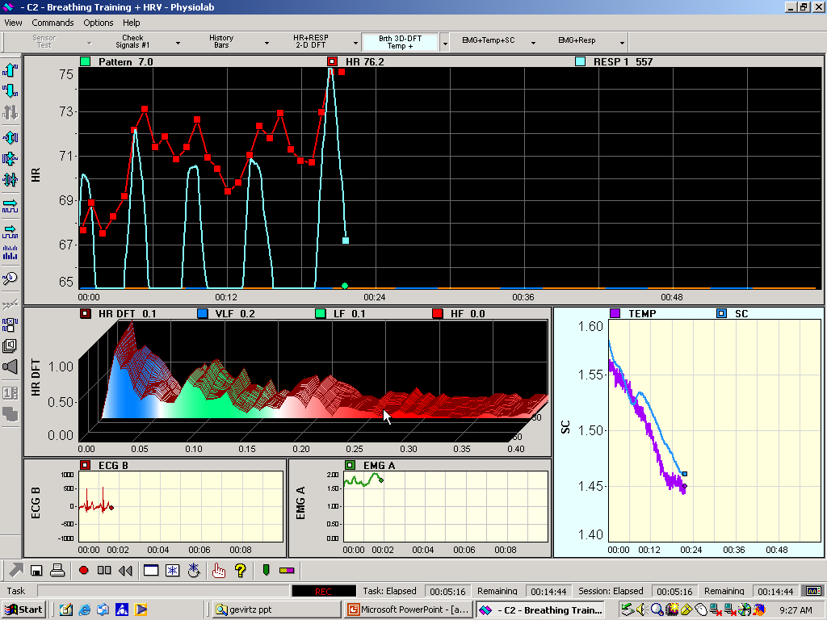
Leah 1
VLF
LF
HF
Notes:
DrG

Slide 70
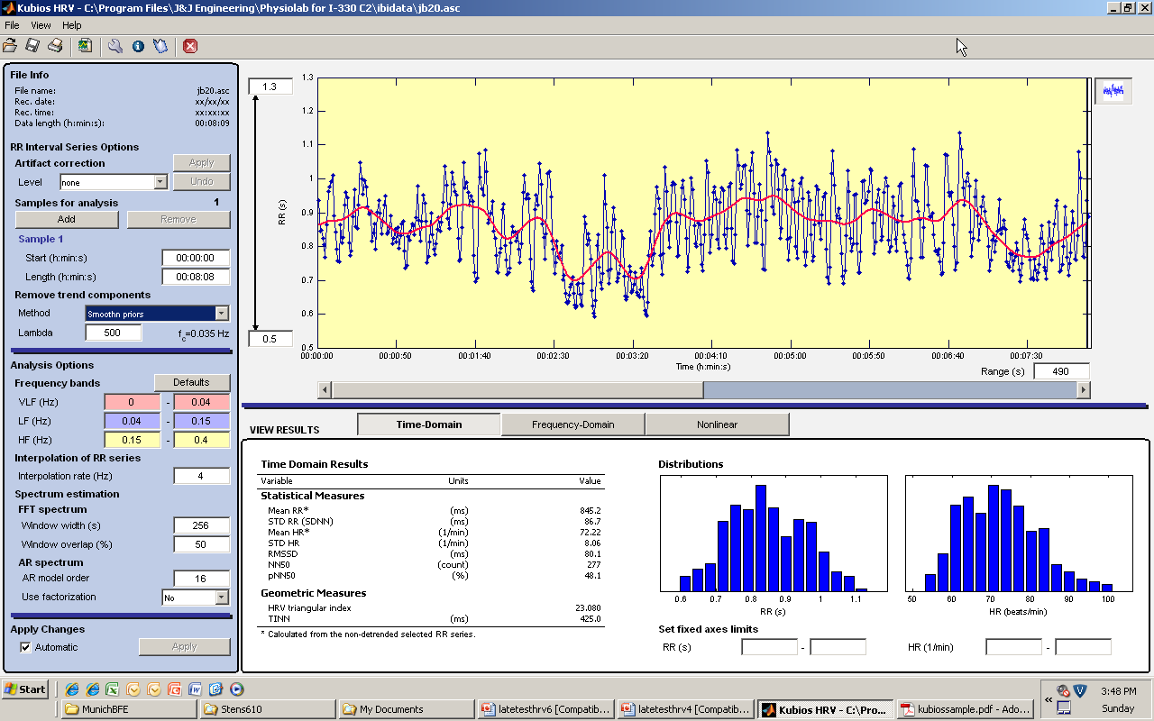
Notes:
DrG

Slide 71
Notes:
DrG

Slide 72
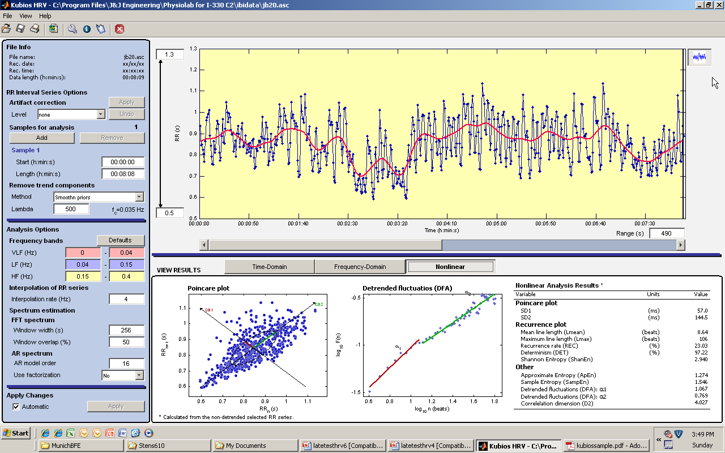
Notes:
DrG

Slide 73
Intake - Psychoeducation
Be sensitive and validating
  Why are they sent to a psych Dr.? Does my dr. think Im crazy?
  “If something is happening in the mind, its happening somewhere in the body”
  Buy-In is extremely important.
    For pediatrics – parental buy-in makes a big difference.
    Need to explain what is happening
      Validates that there is something physical
      And gets them to believe why biofeedback will help
      Without buy-in there is treatment resistance and non-compliance with homework
      Explanation should be technical enough to satisfy adults, yet simple and concise enough for kids
Notes:
MJ
This session more important for them than it is for you.
It important to remember that most of these patients have been made to believe (or even told directly) that this is all in their head. Many GI specialists and even psychologists act as though this exists only in their mind or are feigning. Though there possible secondary gains to consider for behavioral intervention, it is important to remember that few of these cases are malingering and there are physiological mechanisms responsible for their experiences.
Same explanation works for both. (important to find things they can relate to when you discuss stressors.

Slide 74

Session 2
Teach diaphragmatic breathing
Connect patient and reassure
Equipment & screen education
Use breathing amplitude to help with diaphragmatic breathing
Slow down to match RFR
Introduce music and homework
Notes:
DrG
I know how to breathe – Negative ghost rider
Modeling for patient – Mark’s joke
Then do it together
Different strategies
Chest hand/ Tummy hand
Lying down – hospital
Pillow on stomach
If Pt cannot start at their RFR, start them higher with the goal to go down.

Slide 75
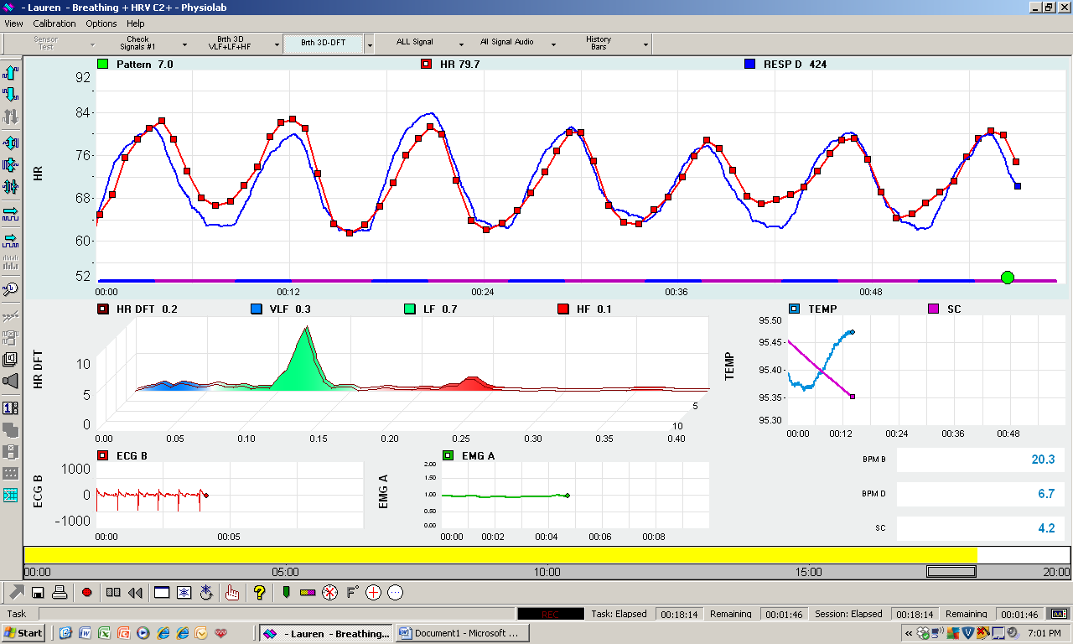
Fig. 1. J&J Screen showing HR, Resp,temp, Skin Cond,
and a spectral analysis. Peak valley differences are about
14 B/M (79-65), LF is .1.
Notes:
DrG
Fig. 1. J&J Screen showing HR, Resp,temp, Skin Cond, and a spectral analysis. Peak valley differences are about 14 B/M (79-65), LF is .1.

Slide 76
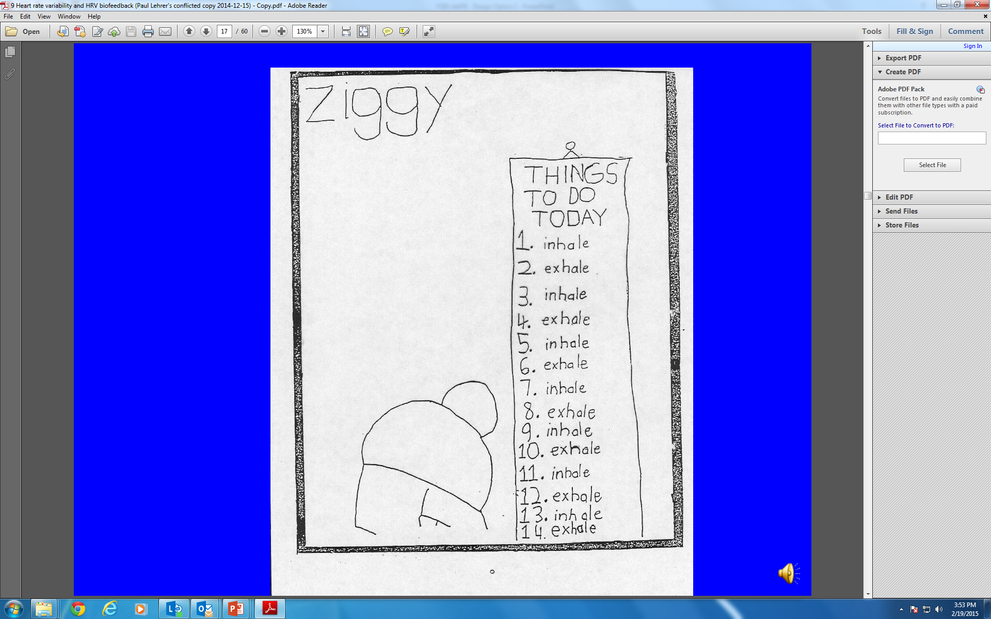

Slide 77
Session 3
  Homework check-in
  Catch and Correct - Be cognizant of whether or not they are matching with their breath
        Fast exhale (want it to be longer than inhale)
          Pursed lip exhale
          Also verbally or gesturally walk them through speed “breath in/ breathe out”
        Broken breathing
        Breathing backwards
        Powerful breath
10 minutes of breathing with Breath-sync©
Encouragement, Encouragement, Encouragement!!!!
Notes:
MJ

Slide 78
Session 4-6
Take new physiological assessment
Biofeedback Assisted Breathing
Supplemental Tools
  Mindfulness based breathing
  Visualizations
  PMR
  Psychosocial Treatments
      ACT
      CBT
Notes:
RG

Slide 79
Termination
Never too early to plan termination
Review of symptoms
      Goal is not necessarily to cure, but to regain daily function.
      Clinical judgment when patient’s symptoms have sufficiently reduced or remitted
Discuss breathing plan post termination
      Introducing apps
      Involve parents
Option to wind down: Once per week to bi-weekly, to monthly follow up
Can offer booster session or long-term follow up (such as 3-6 months. **Do this for you.
Notes:
DrG

Slide 81


Slide 82
References
Aggarwal, A., Cutts, T., Abell, T., Cardoso, S., Familoni, B., Bremer, J., & Karas, J. (1994). Predominant symptoms in irritable bowel syndrome correlate with specific autonomic nervous system abnormalities. Gastroenterology, 106(4), 945-950.
American Gastroenterological Association medical position statement: irritable bowel syndrome. (2002). Gastroenterology, 123(6), 2105-2107.
Apley, J., & Naish, N. (1958). Recurrent abdominal pains: A fieldsurvey of 1,000 school children. Archives of Disease in Childhood, 33(168), 165–170.
Axon AT. Personal view: to treat or not to treat? Helicobacter pylori and gastreo-esophageal reflux disease- an alternative hypothesis. Aliment Pharmacol Ther. 2004;19:253–61.
Brandt, L., Chey, W., Foxx-Orenstein, A., Schiller, L., Schoenfeld, P., Spiegel, B., & ... Quigley, E. (2009). An evidence-based position statement on the management of irritable bowel syndrome. The American Journal of Gastroenterology, 104 Suppl 1S1-S35. doi:10.1038/ajg.2008.122
Corazziari, E. (2004). Definition and epidemiology of functional gastrointestinal disorders. Best Practice & Research. Clinical Gastroenterology, 18(4), 613-631.
Delaney BC. Prevalence and epidemiology of gastroesophageal reflux disease. Aliment Pharmacol Ther.2004;20:2–4
Diaz-Rubio M, Moreno-Elola-Olaso C, Rey E, Locke GR 3rd, Rodriguez-Artalejo F. Symptoms of gastro-esophageal reflux: prevalence, severity, duration and associated factors in a Spanish population.Aliment Pharmacol Ther. 2004;19:95–105.
Dobbin, A., Dobbin, J., Ross, S. C., Graham, C., & Ford, M. J. (2013). Randomised controlled trial of brief intervention with biofeedback and hypnotherapy in patients with refractory irritable bowel syndrome. J R Coll Physicians Edinb, 43(1), 15-23.
Dobrek, L., Nowakowski, M., Mazur, M., Herman, R., & Thor, P. (2004). Disturbances of the parasympathetic branch of the autonomic nervous system in patients with gastroesophageal reflux disease (GERD) estimated by short-term heart rate variability recordings. Journal Of Physiology And Pharmacology: An Official Journal Of The Polish Physiological Society, 55 Suppl 277-90.
Drossman, D.A. (2006). The functional gastrointestinal disorders and the Rome III process. Gastroenterology, 130: 1377-1390.
Ehrlein, H.J., & Schemann, M. (n.d.). Gastrointestinal motility. Humanbiology.wzw.tum.de. Retreived October 1, 2013, from http://humanbiology.wzw.tum.de/fileadmin/Bilder/tutorials/tutorial.pdf
Eisen G. The epidemiology of gastroesophageal reflux disease: what we know and what we need to know. Am J Gastroenterol. 2001;96:S16–8.
Farnam, A., Somi, M. H., Sarami, F., & Farhang, S. (2008). Five personality dimensions in patients with irritable bowel syndrome. Neuropsychiatric Disease and Treatment, 4(5), 959-962.
Ferreira, N. B. (2011). Investigating the role of psychological flexibility and the use of an acceptance and commitment therapy based intervention in irritable bowel syndrome (Doctoral dissertation). The University of Edinburgh. Retrieved from http://hdl.handle.net/1842/6312.
Goyal, R., & Hirano, I. (1996). The enteric nervous system. The New England Journal Of Medicine, 334(17), 1106-1115.
Grover, M., & Drossman, D. (2010). Functional abdominal pain. Current Gastroenterology Reports, 12(5), 391-398. doi:10.1007/s11894-010-0125-0
Hansen JM, Wildner-Christensen M, Schaffalitzky de Muckadell OB. Gastroesophageal reflux symptoms in a Danish population: a prospective follow-up analysis of symptoms, quality of life, and health-care use. Am J Gastroenterol. 2009;104:2394–403.
Haque M, Wyeth JW, Stace NH, Talley NJ, Green R. Prevalence, severity and associated features of gastro-esophageal reflux and dyspepsia:a population-based study. N Z Med J. 2000;113:178–81.

Slide 83
References
Hobbis, I., Turpin, G., & Read, N. (2003). Abnormal illness behaviour and locus of control in patients with functional bowel disorders. British Journal of Health Psychology, 8(Pt 4), 393-408.
Hölzl, R., & Whitehead, W. E. (1983). Psychophysiology of the gastrointestinal tract: Experimental and clinical applications. New York: Plenum Press.
Humphreys, P. A., & Gevirtz, R.N. . (2000). Treatment of recurrent abdominal pain: components analysis of four treatment protocols. . Journal of Pediatric Gastroenterology & Nutrition, 31, 47-51.
Hyams, J. S., Burke, G., Davis, P. M., Rzepski, B., & Andrulonis, P.A. (1996). Abdominal pain and irritable bowel syndrome in adolescents: A community-based study. Journal of Pediatrics, 129(2), 220–226.
Jansdottir, G. (1997). The relationship between pains and various discomforts in school children. Childhood: Global Journal of Child Research, 4, 491–504.
Jänig, W. (2006).The integrative action of the autonomic nervous system: Neurobiology of homeostasis. Cambridge, New York: Cambridge University Press.
Kristjansdottir, G. (1996). Sociodemographic differences in the prevalence of self-reported stomach pain in school children. European Journal of Pediatrics, 155(11), 981–983.
Lehrer, P. M., Vaschillo, E., & Vaschillo, B. (2000). Resonant Frequency Biofeedback Training to Increase Cardiac Variability: Rationale and Manual for Training. Applied Psychophysiology & Biofeedback, 25(3), 177-191.
Longstreth, G. (2007). Avoiding unnecessary surgery in irritable bowel syndrome. Gut, 56(5), 608-610.
Louis E, DeLooze D, Deprez P, Hiele M, Urbain D, Pelckmans P, Devière J, Deltenre M. Heartburn in Belgium: prevalence, impact on daily life, and utilization of medical resources. Eur J Gastroenterol Hepatol.2002;14:279–84.
Masters, K. S. (2006). Recurrent Abdominal Pain, Medical Intervention, and Biofeedback: What Happened to the Biopsychosocial Model?. Applied Psychophysiology & Biofeedback, 31(2), 155-165. doi:10.1007/s10484-006-9016-4
Mayer, E. A. (2011). Gut feelings: the emerging biology of gut–brain communication. Nature Reviews Neuroscience, 12(8), 453-466.
Mazur, M., Furgała, A., Jabłoński, K., Madroszkiewicz, D., Ciećko-Michalska, I., Bugajski, A., & Thor, P. (2007). Dysfunction of the autonomic nervous system activity is responsible for gastric myoelectric disturbances in the irritable bowel syndrome patients. Journal of Physiology and Pharmacology: An Official Journal of the Polish Physiological Society, 58 Suppl 3131-139.
McOmber, M., & Shulman, R. (2008). Pediatric functional gastrointestinal disorders. Nutrition In Clinical Practice: Official Publication Of The American Society For Parenteral And Enteral Nutrition, 23(3), 268-274. doi:10.1177/0884533608318671
Mitre, M.C., Katska, D.A. (2004). Pathophysiology of GERD: Lower esophageal sphincter defects. GERD IN THE 21ST CENTURY, SERIES-5; Practical Gastroenterology, 28, 44-58
Nozu, T., & Okumura, T. (2011). Visceral sensation and irritable bowel syndrome; with special reference to comparison with functional abdominal pain syndrome. Journal Of Gastroenterology & Hepatology, 26122-127. doi:10.1111/j.1440-1746.2011.06636.x
Nyrop, K. A., Palsson, O. S., Levy, R. L.., Von Korff, M., Feld A. D., Turner, M. J., & Whitehead, W. E. (2007). Costs of health care for irritable bowel syndrome, chronic constipation, functional diarrhea, and functional abdominal pain. Aliment Pharmacological Therapy, 26(2), 237-248.
Orr, W., Elsenbruch, S., & Harnish, M. (2000). Autonomic regulation of cardiac function during sleep in patients with irritable bowel syndrome. The American Journal of Gastroenterology, 95(10), 2865-2871.

Slide 84
References
Oster, J. (1972). Recurrent abdominal pain, headache and limb pains in children and adolescents. Pediatrics, 50(3), 429–436.
Palsson, O., & Whitehead, W. (2013). Psychological treatments in functional gastrointestinal disorders: a primer for the gastroenterologist. Clinical Gastroenterology and Hepatology: The Official Clinical Practice Journal of the American Gastroenterological Association, 11(3), 208. doi:10.1016/j.cgh.2012.10.031
Parcel, G. S., Nader, P. R., & Meyer, M. P. (1977). Adolescent health concerns, problems, and patterns of utilization in a triethnic urban population. Pediatrics, 60(2), 157–164.
Pellissier, S., Dantzer, C., Canini, F., Mathieu, N., & Bonaz, B. (2010). Psychological adjustment and autonomic disturbances in inflammatory bowel diseases and irritable bowel syndrome. Psychoneuroendocrinology, 35(5), 653-662. doi:10.1016/j.psyneuen.2009.10.004
Pfeiffer, R. (2001). Brain meets gut: gastroesophageal reflux. Clinical Autonomic Research: Official Journal Of The Clinical Autonomic Research Society, 11(1), 3-4.
Rey, E., Moreno Ortega, M., Garcia Alonso, M., & Diaz-Rubio, M. (2009). Constructive thinking, rational intelligence and irritable bowel syndrome. World Journal of Gastroenterology: WJG, 15(25), 3106-3113.
Saito, Y.A., Locke, G.R., Weaver, A.L., Zinsmeister, A.R., Talley, N.J. (2005). Diet and Functional Gastrointestinal disorders. American Journal of Gastroenterology, 100(12):2743-8.
Schuster, M. (2001). Defining and diagnosing irritable bowel syndrome. The American Journal of Managed Care, 7(8 Suppl), S246-S251.
Shapiro, M., Shanani, R., Taback, H., Abramowich, D., Scapa, E., & Broide, E. (2012). Functional chest pain responds to biofeedback treatment but functional heartburn does not: what is the difference?. European journal of gastroenterology & hepatology, 24(6), 708-714.
Sowder, E., Gevirtz, R., Shapiro, W., & Ebert, C. (2010). Restoration of Vagal Tone: A Possible Mechanism for Functional Abdominal Pain. Applied Psychophysiology and Biofeedback.
Sperber, A., & Drossman, D. (2010). Functional abdominal pain syndrome: constant or frequently recurring abdominal pain. The American Journal Of Gastroenterology, 105(4), 770-774. doi:10.1038/ajg.2010.68
Sulkowska, A., Swinarska-Naumiuk, M., Jasiński, A., Janiak, M., Burkiewicz, A., Sulkowski, B., & ... Smoczyński, M. (2008). Description and comparison of emotional factors in patients with irritable bowel syndrome and gastroesophageal reflux disease. Gastroenterologia Polska / Gastroenterology, 15(4), 219-224.
Surdea-Blaga, T., Băban, A., & Dumitrascu, D. (2012). Psychosocial determinants of irritable bowel syndrome. World Journal of Gastroenterology: WJG, 18(7), 616-626. doi:10.3748/wjg.v18.i7.616
Stern, M.J., Guiles, R.A.F., & Gevirtz, R. (2014). HRV biofeedback for pediatric irritable bowel syndrome and functional abdominal pain: Clinical replication series. Applied Psychophysiology & Biofeedback. doi: 10.1007/s10484-014-9261-x
Straub, R. O. (2012). Health psychology. New York, NY US: Worth Publishers
Task Force of the European Society of Cardiology and the North American Society of Pacing and Electrophysiology. (1996). Heart rate variability. Standards of measurement, physiological interpretation, and clinical use. European Heart Journal, 17(3), 354-381.
Thomas, C. (2011). A mixed methods investigation of heart rate variability training for women with irritable bowel syndrome. Dissertation Abstracts International, 72.
Thompson, W., Irvine, E., Pare, P., Ferrazzi, S., & Rance, L. (2002). Functional gastrointestinal disorders in Canada: first population-based survey using Rome II criteria with suggestions for improving the questionnaire. Digestive Diseases and Sciences, 47(1), 225-235.
Wahlquist P, Karlsson M, Johnson D, Carlsson J, Bolge SC, Wallander MA. Relationship between symptom load of gastro-esophageal reflux disease and health-related quality of life, work productivity,

Slide 85
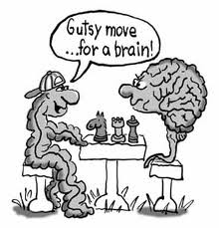
Questions?

